Slide 1

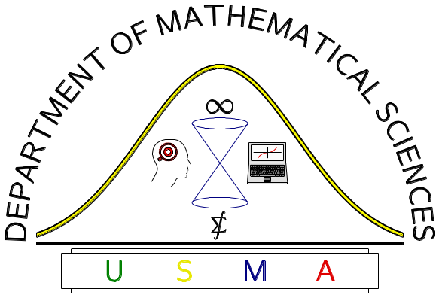
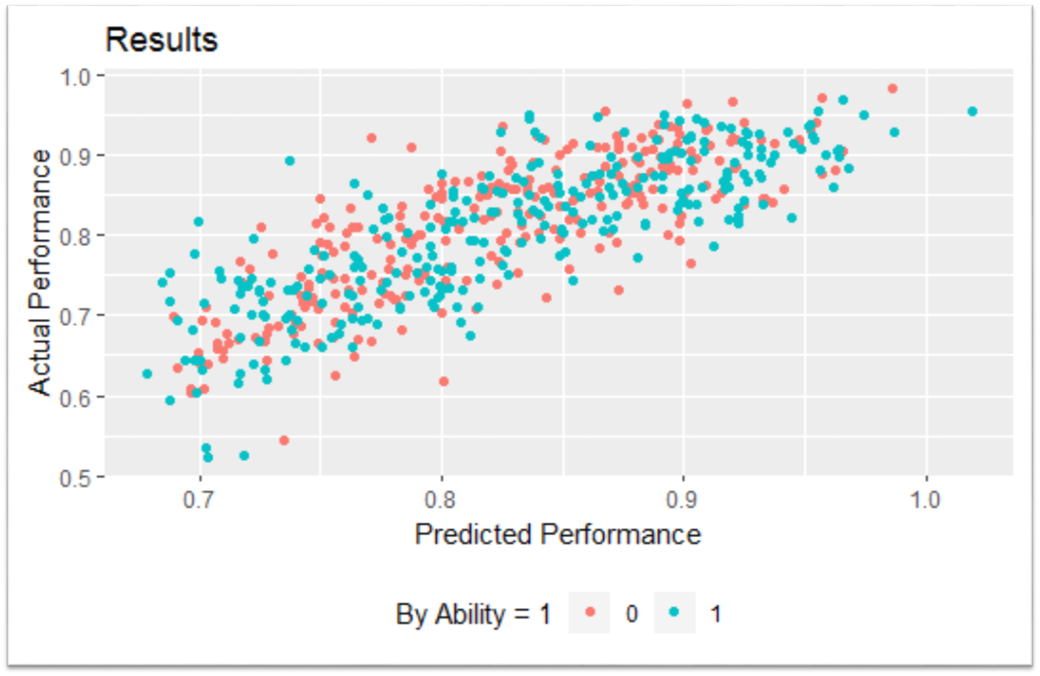
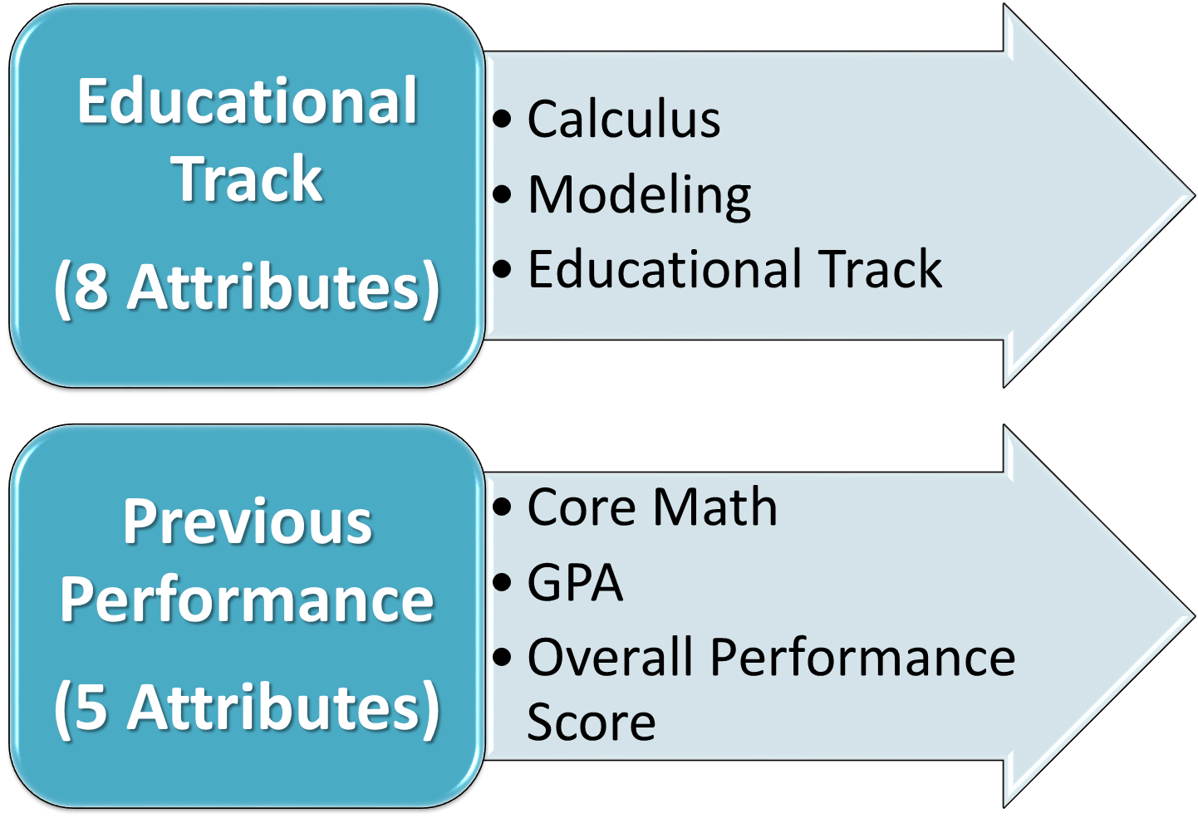
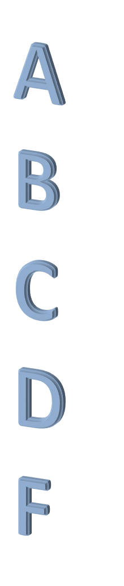
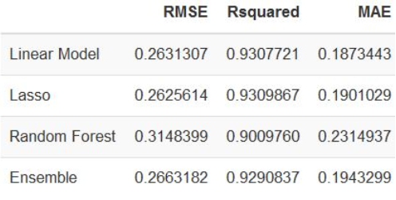
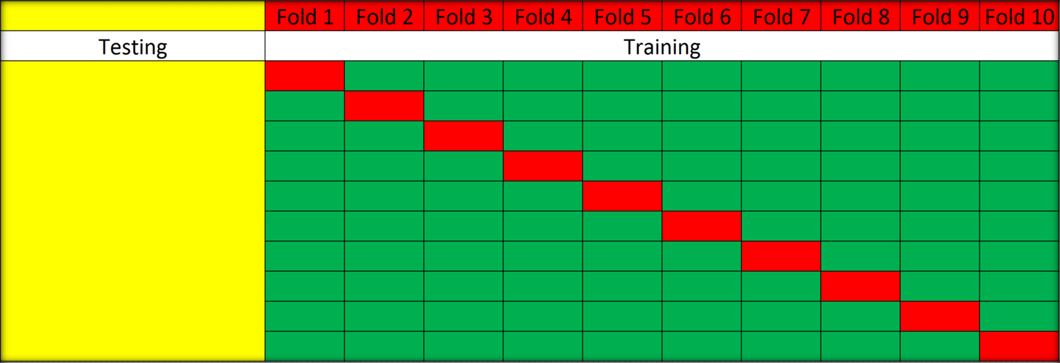
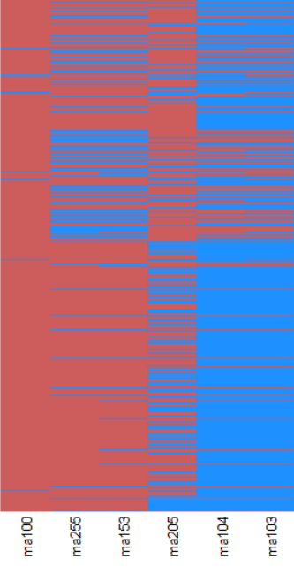
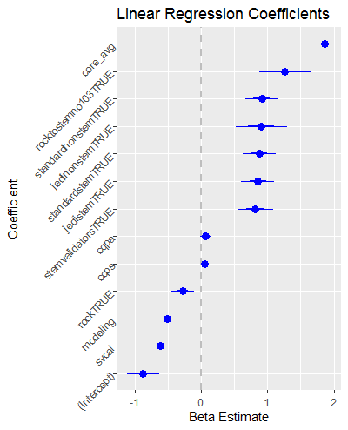
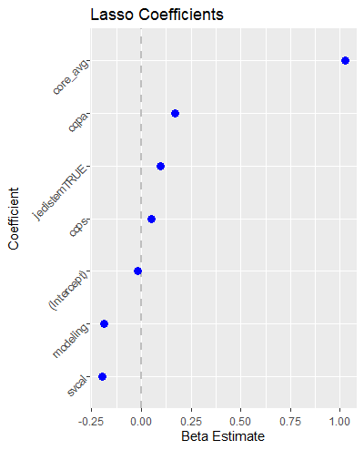

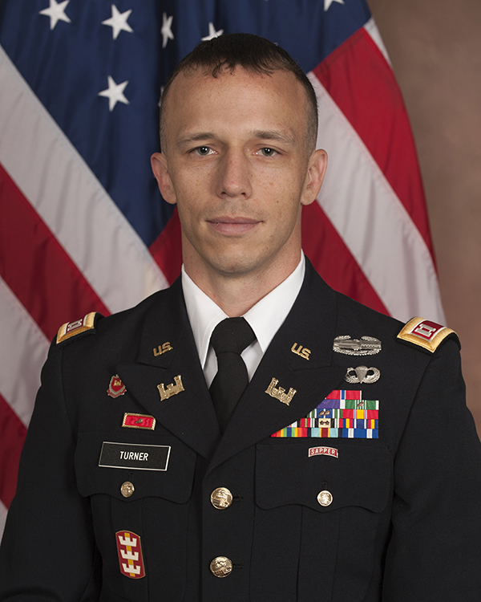
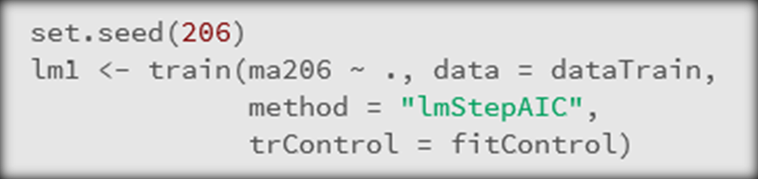
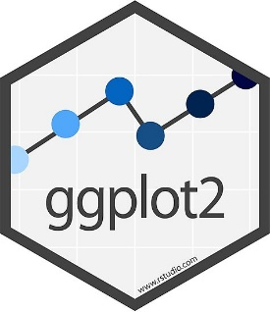
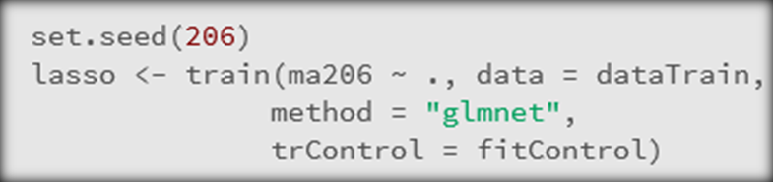

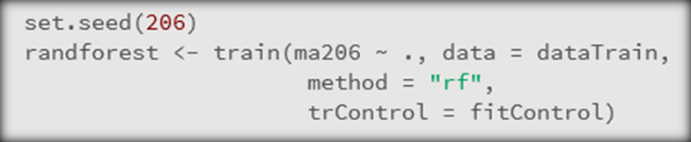




Modeling Performance in the Undergraduate Statistics Classroom
CPT DUSTY TURNER
UNITED STATES MILITARY ACADEMY
Goal: Identify what factors influence a cadet’s statistical learning
Model Control Structure
Ensemble Model
75% Training / 25% Testing
Structure
  Tune parameters using repeated cross validation
  Select parameters based on best cross validation score
Data Wrangling
Model Execution
1019 Cadets over 2 Semesters
Identify Track
  Advanced/Standard/STEM/
  Non STEM/Remedial
Collapse Factors
  SV/MV Calculus and Modeling
Impute Missing Data
  <1% with K-NN (K=5)
Center/Scale
dusty.s.turner.mil@mail.mil
dusty.s.turner@gmail.com
https://github.com/dusty-turner
@dtdusty
https://dusty-turner.netlify.com/
Predict on holdout set for
each model

